Slide 1
Chapter 7: Moving on to Design

Slide 2
Learning Objectives
Understand the verification and validation of the analysis models.
Understand the transition from analysis to design.
Understand the use of factoring, partitions, and layers.
Be able to create package diagrams.
Be familiar with the custom, packaged, and outsource design alternatives.
Be able to create an alternative matrix.
Notes:
In Chapter #7 we will talk about the highlighted items.

Slide 3
Introduction
Analysis determines the business needs
Design activities focus on how to build the system
Major activity is to evolve the models into a design
Goal is to create a blueprint for the design that makes sense to implement
Determine how and where data will be stored
Determine how the user will interface with the system (user interface, inputs and outputs)
Decide on the physical architecture
Analysis and design phases are highly interrelated and may require much “going back and forth”
Example: prototyping may uncover additional information
Notes:
What actually goes on during the Design Phase?.
What is the goal of the design phase?
Why do we need such a detailed blueprint?

Slide 4
The Design Process
Verify and validate the analysis models
Evolve the analysis models into design models
Create packages and utilize package diagrams
Decide upon a design strategy
Notes:
What is the difference between an analysis model and a design model?

Slide 5
Verifying & Validating the Analysis Models
Do the analysis models accurately represent the problem domain?
Test the fidelity of each model
Example: activity diagrams, use-case descriptions and use-case diagrams should all describe the same functional requirements
Balance the models to ensure consistency between them
Notes:
What is a walkthrough?
What is a “maintenance oracle”?

Slide 6
Balancing Functional & Structural Models
A class on a class diagram must be associated with at least one use-case
An activity in an activity diagram and an event in a use-case description should be related to one or more operations on a class diagram
An object node on an activity diagram must be associated with an instance or an attribute on a class diagram
An attribute or an association/aggregation relationship on a class diagram should be related to the subject or object of a use-case
Notes:
What is meant by balancing the models?

Slide 7
Balancing Functional & Behavioral Models
Sequence & communication diagrams must be associated with a use-case
Actors on sequence & communication diagrams or CRUDE matrices must be associated with actors within a use-case
Messages on sequence & communication diagrams, transitions on behavioral state machines and entries in a CRUDE matrix must relate to activities on an activity diagram and events in a use-case
All complex objects in activity diagrams must be represented in a behavioral state machine
Notes:
What are examples of Functional Models?
What are examples of Behavioral Models?
What do we have to do the ensure they BALANCED?

Slide 8
What is meant by balancing the models?

Slide 9
What are the interrelationships between the functional, structural, and the behavioral models that need to be tested?

Slide 10
What is the goal of the design phase?

Slide 11
Why do we need the detailed blueprint we create during the design phase?

Slide 12
What is the difference between an analysis model and a design model?

Slide 13
What is a walkthrough?

Slide 14
What are examples of Functional Models?

Slide 15
In the design phase we address the functional requirements.
T / F

Slide 16
What are examples of Behavioral Models?

Slide 17
What do we have to do the ensure they BALANCED?

Slide 18
Evolving the Analysis Models into Design Models
Analysis models focused on functional requirements
Design models must include non-functional requirements as well
System performance
System environment issues
Distributed vs. centralized processing
User interface
Database
The system must be maintainable and affordable, efficient and effective
Utilize factoring, partitions & collaborations, and layers
Notes:
Can we use the use cases & objects we collected so far to in the design phase?
How do you “refine’ an analysis phase use case?
Refining a use case is a very tedious task why go though all that effort?

Slide 19
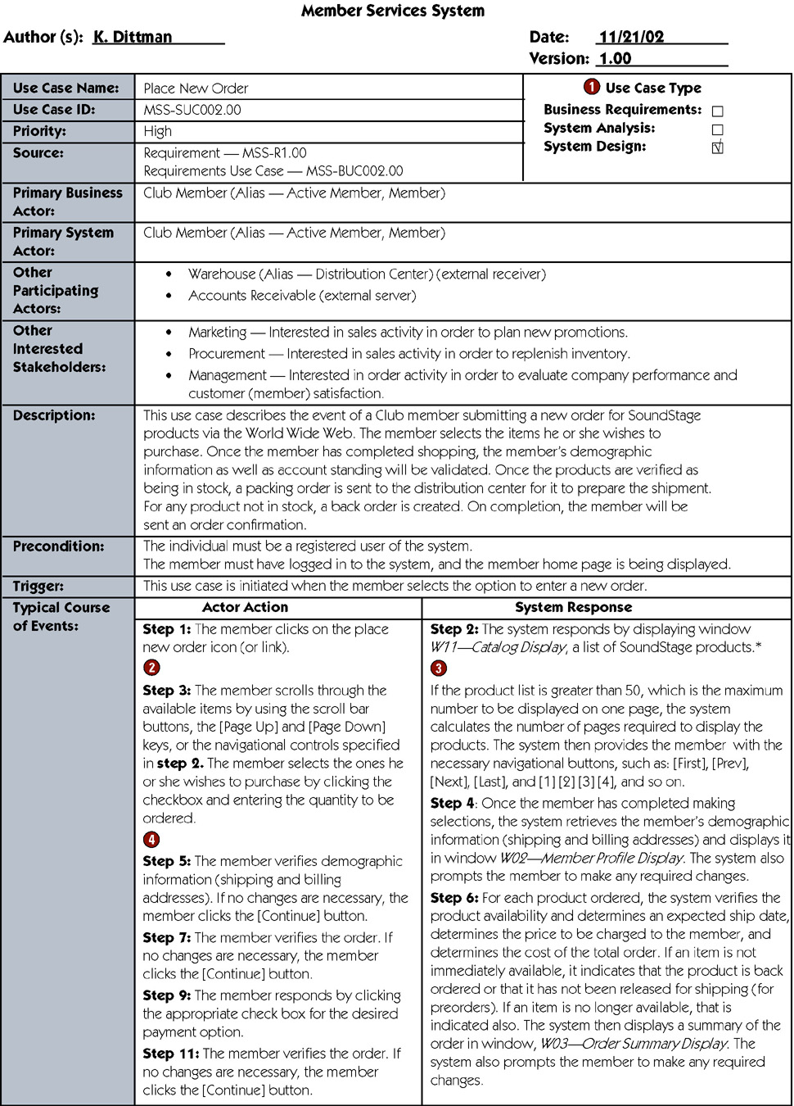
Design Use Case
Notes:
Why did we check system design in the box with the red circle?

Slide 20
Design Use Case (continued)
Notes:
What did we accomplish with the additions made by adding the content below the red dots?

Slide 21
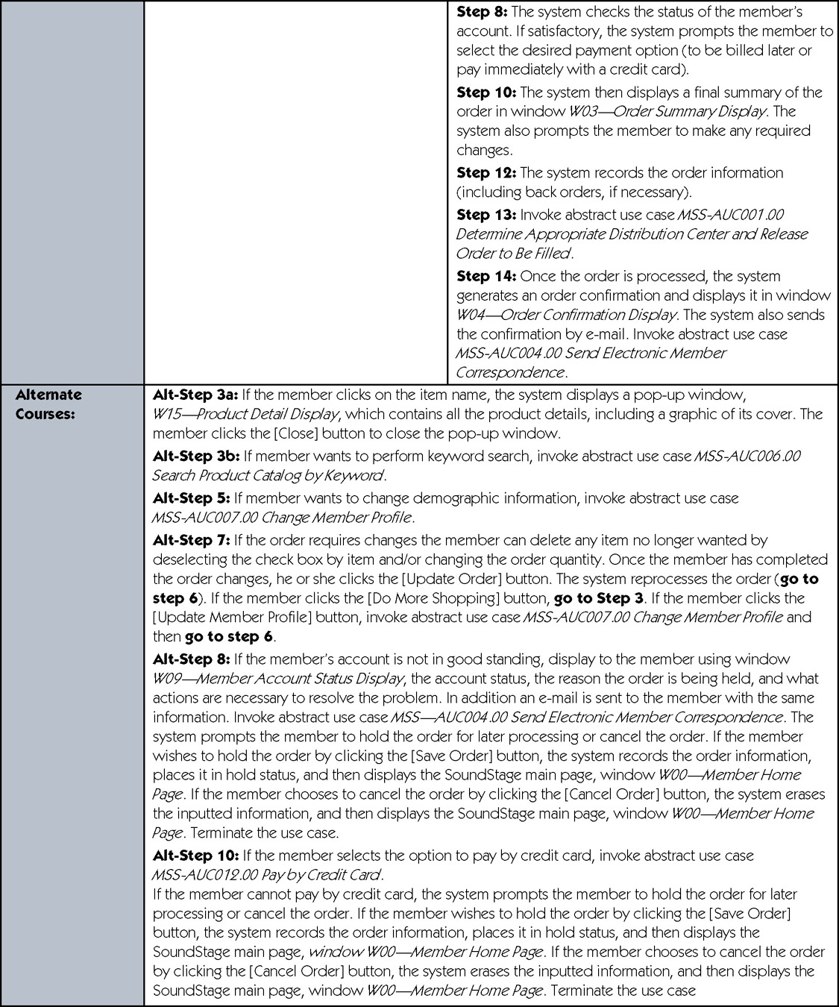
Design Use Case (continued)
Notes:
Can these transformed design use cases ever impact our analysis use cases?
If new use cases, use case dependencies or new actors have been discovered how do you handle them?

Slide 22
Balancing Structural & Behavioral Models
Objects in a CRUDE matrix must be associated with classes
Behavioral state machine must be associated with objects on a class diagram
Objects in sequence and communication diagrams must be associated with objects on a class diagram
Messages on sequence and communication diagrams and transitions on behavioral state machines must be associated with operations in a class
States in a behavioral state machine must match the different values of an attribute of an object
Notes:
How do you balance the functional and structural models?.
What are some techniques you can use to Balancing Structural & Behavioral Models?

Slide 23
Factoring
Creating modules that account for similarities and differences between units of interest
New classes formed through a:
Generalization (a-kind-of) relationship, or a
Aggregation (has-parts) relationship
Abstraction—create a higher level class (e.g., create an Employee class from a set of job positions)
Refinement—create a detailed class (e.g., create a secretary or bookkeeper from the Employee class)
Notes:
What does factoring mean?
How is it related to abstraction and refinement?

Slide 24
Partitions and Collaborations
Partition: create a sub-system of closely collaborating classes
Base partitions on patterns of activity (e.g., collaborations found in a communication diagram)
Greater coupling among classes may identify partitions (e.g., more messages passes between objects suggests that they belong in the same partition)
Identifying partitions and collaborations determines which classes should be grouped together
Notes:
What is a partition?
What are some examples of partitions?
How do we determine which objects system collaborate?
How does a partition relate to collaboration?

Slide 25
Layers
System environment information must now be added
Use layers to represent and separate elements of the software architecture
Easier to understand a complex system
Example:
Model-view-controller (MVC) architecture
Separates application logic from user interface
Notes:
What is a layer?
Why do we need several different layers?
How many different layers or elements of a software architecture are there & what are their names?

Slide 26
Layers
Use layers to represent and separate elements of the software architecture
Proposed layers:
Foundation (e.g., container classes)
Problem domain (e.g., encapsulation, inheritance, polymorphism)
Data management (e.g., data storage and retrieval)
User interface (e.g., data input forms)
Physical architecture (e.g., specific computers and networks)
Notes:
What issue does the data management layer address?
What types of classes can appear in the data management layer?
What issue does the user interface layer address?

Slide 27
Layers
Use layers to represent and separate elements of the software architecture
Proposed layers:
Foundation (e.g., container classes)
Problem domain (e.g., encapsulation, inheritance, polymorphism)
Data management (e.g., data storage and retrieval)
User interface (e.g., data input forms)
Physical architecture (e.g., specific computers and networks)
Notes:
What types of classes can appear in the user interface layer?
What issue does the physical architecture layer address?
What types of classes can appear in the physical architecture layer?

Slide 28
Packages and Package Diagrams
Packages group together similar components (e.g., use-cases, class diagrams)
Package diagrams show the packages and their relationships
Aggregation & association relationships are possible
Packages may be dependent upon one another
If one package is modified, others that depend on it may also require modification
Notes:
What is a package?
How are packages related to partitions and layers?
What is a dependency relationship?

Slide 29
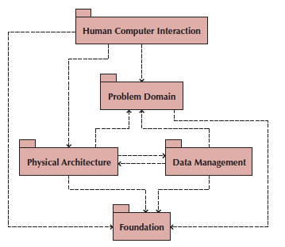
Sample Package Diagram
Notes:
This is a package diagram. What are packages again?
What value do package diagrams have for stakeholders?
What are package diagrams used for?
What do the arrows tell us?

Slide 30
Sample Package Diagram
Notes:
How do you perform a verifying and validating walkthrough of a package diagram?

Slide 31
Guidelines for Building Package Diagrams
Use them to logically organize your design
Observe semantic relationships
Vertical positioning indicates inheritance
Horizontal positioning indicates aggregation and association
Dependency relationships should also observe semantic relationships
For use-case package diagrams, include the actors
Use simple but descriptive names for each package
Make packages cohesive
Notes:
This slide shows some guidelines for building package diagrams. What are the things you look for to determine if packages make sense for your project?
After you select among your package “candidates” what do you do next?

Slide 32
Building Package Diagrams
Set the context
Cluster classes together based on shared relationships
Create packages from the clusters
Identify dependency relationships among packages
Lay out and draw the diagram including only the packages and their dependencies
Verify and validate the package diagram
Notes:
What needs to be verified and validated in package diagrams?
When drawing package diagrams, what guidelines should you follow?

Slide 33
How do you perform a verifying and validating walkthrough of a package diagram?

Slide 34
How do you “refine’ an analysis phase use case?

Slide 35
How do you balance the functional and structural models?

Slide 36
What does factoring mean?

Slide 37
How is factoring related to abstraction and refinement?

Slide 38
What is a partition?

Slide 39
What are some examples of partitions?

Slide 40
How do we determine which objects system collaborate?

Slide 41
How does a partition relate to collaboration?

Slide 42
What is a layer?

Slide 43
Why do we need several different layers?

Slide 44
What issue does the data management layer address?

Slide 45
What issue does the user interface layer address?

Slide 46
What issue does the physical architecture layer address?

Slide 47
What is a package?

Slide 48
How are packages related to partitions and layers?

Slide 49
What is a dependency relationship?

Slide 50
What value do package diagrams have for stakeholders?

Slide 51
What are the things you look for to determine if packages make sense for your project?

Slide 52
What needs to be verified and validated in package diagrams?

Slide 53
A(n) _____ is the equivalent to a subsystem.
a. collaboration
b. partition
c. layer
d. factor
e. abstraction

Slide 54
Which the following class should be designed in layer Foundation.
a. Date
b. DataInputStream
c. Button
d. Student
e. URLConnection

Slide 55
A package diagram is a class diagram that shows only packages and classes.
T / F

Slide 56
Design Strategies
Custom development—build it in house from scratch
Purchase packaged software
Office suites (e.g., word processors, spreadsheets, etc.)
Enterprise systems (e.g., SAP, PeopleSoft)
Hire an external vendor (outsource)
Notes:
How do you determine the best option to choose?

Slide 57
Custom Development
Allows for meeting highly specialized requirements
Allows flexibility and creativity in solving problems
Easier to change components
Builds personnel skills
May excessively burden the IT staff
May add significant risk
Notes:
Describe the custom development design strategy.
What are the advantages of selecting a custom development design strategy?
What are the disadvantages of selecting a custom development design strategy?

Slide 58
Packaged Software
Software already written (e.g., accounting software)
May be more efficient
May be more thoroughly tested and proven
May range from components to tools to entire enterprise systems
Must accept functionality provided
May require change in how the firm does business
May require significant “customization” or “workarounds”
Notes:
Describe the packaged system design strategy.
What are the advantages of selecting a Packaged Software design strategy?
What are some problems with using a packaged software approach to building a new system?

Slide 59
Packaged Software
Software already written (e.g., accounting software)
May be more efficient
May be more thoroughly tested and proven
May range from components to tools to entire enterprise systems
Must accept functionality provided
May require change in how the firm does business
May require significant “customization” or “workarounds”
Notes:
How can the problems associated with package software be addressed?
What are the pros of using a workaround?
What are the cons of using a workaround?

Slide 60
System Integration
Building a new system by combining packages, legacy systems, and new software
Not uncommon to purchase off the shelf software and outsource its integration to existing systems
Key challenge is integrating data
May require data transformations
New package may need to write data in the same format as a legacy system
Develop “object wrappers”
Wraps the legacy system with an API to allow newer systems to communicate with it
Protects the investment in the legacy system
Notes:
Why do companies invest in ERP systems?
What is an “object wrapper”?
How can an “object wrapper” be used to help integrate systems?

Slide 61
Enterprise Applications - EAI
Enterprise Application Integration (EAI) – the process and technologies used to link applications to support the flow of data and information between those applications.
Middleware – software (usually purchased) used to translate and route data between different applications.
Notes:
Most Companies have older, big computer based applications called Legacy Systems. They need to keep abreast by purchasing or developing new, more contemporary applications like ERP and even Internet Applications. How do the get all these applications which incorporate different technologies to interoperate?
What is another name for an EAI package?
What is middleware?

Slide 62
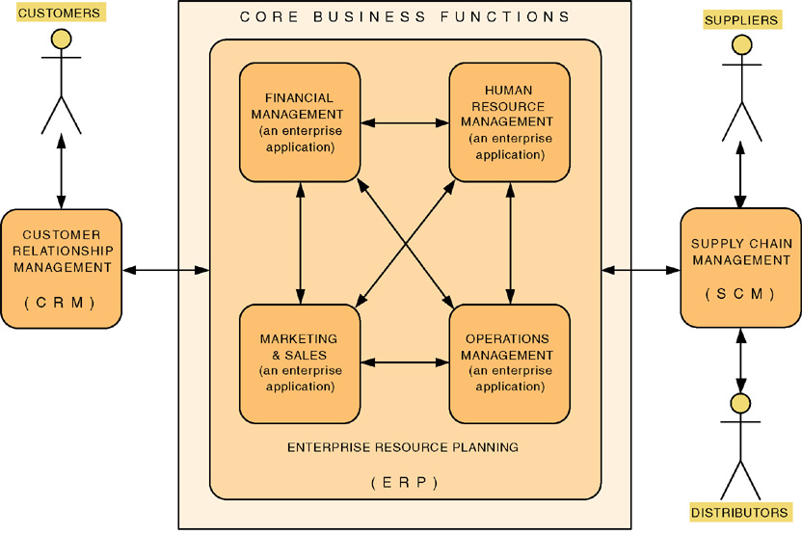
Enterprise Applications
Notes:
An enterprise application in an integrated set of core business applications - finance, marketing, sales, human resources, operations . They are usually purchased from third party vendors. Do most companies modify their business processes to conform to the software they purchase?

Slide 63
Outsourcing
Hire an external firm to create the system
Requires extensive two-way coordination, information exchange and trust
Disadvantages include loss of control, compromise confidential information, transfer of expertise
Carefully choose your vendor
Carefully prepare the contract and method of payment
Contract types:
Time-and-arrangement: pay for all time and expenses
Fixed-price: pay an agreed upon price
Value-added: pay a percentage of benefits
Notes:
Describe the outsourcing design strategy.
What are the advantages of selecting a outsourcing design strategy?
What are the advantages of selecting a outsourcing design strategy?

Slide 64
Outsourcing
Hire an external firm to create the system
Requires extensive two-way coordination, information exchange and trust
Disadvantages include loss of control, compromise confidential information, transfer of expertise
Carefully choose your vendor
Carefully prepare the contract and method of payment
Contract types:
Time-and-arrangement: pay for all time and expenses
Fixed-price: pay an agreed upon price
Value-added: pay a percentage of benefits
Notes:
How can you reduce the inherent risk associated with an outsourcing strategy?
When is outsourcing considered a good design strategy?
When is outsourcing not appropriate?

Slide 65
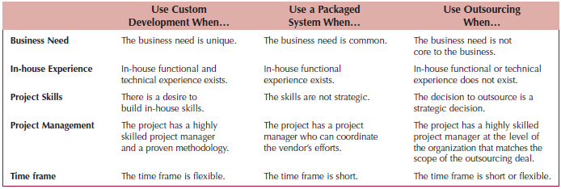
Selecting a Design Strategy
Notes:
Explain how the “in-house experience” factor influences the selection of a design strategy for a project.
Explain how the “business need” factor influences the selection of a design strategy for a project.
What are the differences between the time and arrangements, fixed-price, and value-added contracts for outsourcing?

Slide 66
Selecting a Design Strategy
Notes:
How does the factor “project skills” influence the selection of a design strategy for a project?
How doe the “project management” factor influence the selection of a design strategy for a project?

Slide 67
Selecting a Design Strategy
Notes:
How does the “time frame” factor influences the selection of a design strategy for a project?.

Slide 68
SELECTING AN ACQUISITION STRATEGY
Determine tools and skills needed for in-house development
Identify existing packages that satisfy the users’ needs
Locate companies who can build it under contract
Create an alternative matrix to organize the pros and cons of each possible choice
Incorporate technical, economic and organizational feasibility
Utilize an RFP or RFI to obtain cost & time estimates from potential vendors
Notes:
What is the purpose of an alternatives matrix?
What is the typical content of an alternatives matrix?

Slide 69
SELECTING AN ACQUISITION STRATEGY
Determine tools and skills needed for in-house development
Identify existing packages that satisfy the users’ needs
Locate companies who can build it under contract
Create an alternative matrix to organize the pros and cons of each possible choice
Incorporate technical, economic and organizational feasibility
Utilize an RFP or RFI to obtain cost & time estimates from potential vendors
Notes:
How will this tool be used by a project team in the context of design strategy selection?
How are the alternative matrix and feasibility analysis related?

Slide 70
SELECTING AN ACQUISITION STRATEGY
Determine tools and skills needed for in-house development
Identify existing packages that satisfy the users’ needs
Locate companies who can build it under contract
Create an alternative matrix to organize the pros and cons of each possible choice
Incorporate technical, economic and organizational feasibility
Utilize an RFP or RFI to obtain cost & time estimates from potential vendors
Notes:
What is an RFP?
What is an RFI?

Slide 71
To avoid the classic design mistake of “reducing the design time,” the analyst should _____.
a. increase the schedule to include learning time
b. move proposed changes into future versions
c. not switch or upgrade unless there is a compelling need for specific features
d. not use a design tool that appears too good to be true
e. use timeboxing

Slide 72
To avoid the classic design mistake of “feature creep,” the analyst should _____.
a. not switch or upgrade unless there is a compelling need for specific features
b. increase the schedule to include learning time
c. move proposed changes into future versions
d. not use a design tool that appears too good to be true
e. use rapid application development techniques or timeboxing

Slide 73
The decision on which design strategy to use depends on _____.
a. how unique the business need is
b. the expertise of the project manager
c. the urgency of the project
d. the amount of in-house experience
e. all of these

Slide 74
Pirate Adventures, Inc., a company that owns and operates hotels in tropical locations, is interested in replacing the 15-year-old room reservation system in all of its hotels. Custom development would be the best design strategy.
T / F

Slide 75
A company adopting an enterprise resource planning (ERP) application, has adopted the strategy of outsourcing. T / F

Slide 76
RFP, RFI and RFQ all could be used by project teams to collect information for making acquisition decision.
T / F

Slide 77
Explain how the “business need” factor influences the selection of a design strategy for a project.

Slide 78
When you are evaluation several different design strategies how do you determine the best option to choose?

Slide 79
Describe the custom development design strategy.

Slide 80
What are the advantages of selecting a custom development design strategy?

Slide 81
Describe the packaged system design strategy.

Slide 82
What are the advantages of selecting a Packaged Software design strategy?

Slide 83
What are the pros of using a workaround?

Slide 84
What is an “object wrapper”?

Slide 85
How can an “object wrapper” be used to help integrate systems?

Slide 86
Describe the outsourcing design strategy.

Slide 87
What are the advantages of selecting a outsourcing design strategy?

Slide 88
Explain how the “in-house experience” factor influences the selection of a design strategy for a project

Slide 89
How does the “time frame” factor influences the selection of a design strategy for a project?

Slide 90
What is the purpose of an alternatives matrix?

Slide 91
What is the typical content of an alternatives matrix?.

Slide 92
How will an alternatives matrix be used by a project team in the context of design strategy selection?

Slide 93
What is an “object wrapper” and how can one be used to help integrate systems?

Slide 94
Kiki, the marketing manager, and Joan, the director of information systems, have just returned from a conference on state-of-the art technology for marketing management. Each day after viewing vendor presentations and listening to other marketing managers discuss “what they don’t have and what they really need,” Kiki and Joan would brain storm ideas and record them in Joan’s laptop. On the flight home, Joan, a successful project manager, and Kiki, an experienced marketing professional, recognize that they have the foundation for a one-of-a-kind marketing management system that would improve the decisions the marketing staff must make. This new system could possibly change the way their primary products are marketed. In the process, this new system could save the company millions of dollars and possibly make millions more. Joan has an expert IS staff that is just completing a production management system. They are always interested in learning new technology and often request additional training. No new projects have been approved by the steering committee.
What would you recommend Kiki and Joan do? Include in your discussion the design strategy selection process and the important characteristics that apply to the strategy selected.

Slide 95
Mariana, the IS manager, has just received a note from the accounting department stating that they wish a new purchasing system could be placed on the priority list. The chief accounting officer (CAO) has just learned that three of their competitors have new purchasing systems. Since purchasing has not been considered a key business function in the past, the CAO is concerned that his department lacks the functional expertise to implement a new purchasing system. She feels that purchasing is becoming a strategic necessity for the company and a new system should be in place by this time next year. The CAO has managed the automation of numerous accounting functions, such as the purchase of a combined general ledger with accounts receivable and accounts payable, the custom development of a just-in-time inventory control system, and the management of a financial projections and stock funds project that was contracted to an outside vendor.
What would you recommend Mariana do? Include in your discussion the design strategy selection process and the important characteristics that apply to the strategy selected.

Slide 96
Read Mini Case #1
Page #278 & #279

Slide 97
What are the benefits Susan should consider if she selects an in house custom software design strategy?
What are the benefits Susan should consider if she selects an in house custom software design strategy?
What are the steps Susan should take before finalizing her “Make vs, By” recommendation?

Slide 98
What are the benefits Susan should consider if she selects an in house custom software design strategy?

Slide 99
What are the benefits Susan should consider if she selects an in house custom software design strategy?

Slide 100
What are the steps Susan should take before finalizing her “Make vs, By” recommendation?

Slide 101
Read Mini Case #2
Page #279

Slide 102
What have you learned about the Director of Operations from your last interaction?
What are your current options?

Slide 103
What have you learned about the Director of Operations from your last interaction?

Slide 104
What are your current options?

Slide 105
Mini Case
Boolean Toys

Slide 106
Boolean Toys
Does screen design affect productivity and user satisfaction?
What about users designing their own screens? Is it okay to permit some degree of personal preference or should a standard policy be used?
The best results usually occur when users manage their own information needs. How do you insure that you design a system that is both powerful and flexible enough for users to operate without special training and support?

Slide 107
Boolean Toys
Does screen design affect productivity and user satisfaction?

Slide 108
Boolean Toys
What about users designing their own screens? Is it okay to permit some degree of personal preference or should a standard policy be used?

Slide 109
Boolean Toys
The best results usually occur when users manage their own information needs. How do you insure that you design a system that is both powerful and flexible enough for users to operate without special training and support?

